Slide 1
Greedy Algorithms
Single Source Shortest Path
Swapnil Biswas
Lecturer, CSE Dept, MIST

Slide 2
Shortest Path Problem Variations
Single Source Single/Multiple Destination
Find a shortest path from a given source (vertex s) to each of the vertices
Single Pair
Given two vertices, find a shortest path between them. Solution to single-source problem solves this problem efficiently, too
All Pairs
Find shortest-paths for every pair of vertices. Dynamic programming algorithm

Slide 3
Single Source Shortest Path Problem
Given a weighted graph (directed or undirected) G = (V, E) and a vertex s∈V
Find for all vertices v∈V the minimum possible weight for path from s to v
The weight of path p = v₁ → v₂ → … → v_{k} is
Shortest path = a path of the minimum weight
Algorithm will compute a shortest-path tree
Can be solved by Greedy method
If all edge weights are equal, the problem is solved by BFS in Θ(V + E) time

Slide 4
SSSP Optimal Substructure Property
Sub path of shortest path are shortest
P1
Assume there are 2 paths from A to B
A
U
V
B
P: A->P1->B
P’: A->P2->B
P2
Among P and P’, P is shortest
So, w(p) < w(p’) … … … (1)
We need to prove that: as P is shortest, so every sub path on P is shortest
If we can prove that, P1 is shortest, then we will be able to claim that every path on P is shortest
For a contradiction we assume that, P1 is not the shortest path from u to v
So, P2 is the shortest path from u to v
Means, w(p2) < w(p1)
So, if P1 is no shortest, then P is also not shortest
w(AU) +w(p2)+w(VB) < w(AU)+w(p1)+w(VB)
So, P is shortest if and only if P1 is shortest
w(P’) < w(P)
So, a path is shortest if and only if all of the sub paths on it are shortest
In that case, P is not the shortest path

Slide 5
SSSP Algorithms
Dijkstra’s Algorithm
Bellman Ford Algorithm

Slide 6
Dijkstra Algorithm
Let’s understand the topic with a very small example
Find the shortest path of all vertices from 1 (Source)
3
Source
1
| 0
2
| 3
7
15
| 10
3

Slide 7
Dijkstra Algorithm
Store the shortest distance from source for all vertex at the end
Prim’s Algorithm will help us
Min Node
Min Node
3
Source
1
| ∞
| ∞
0
2
3
7
15
| ∞
3
15

Slide 8
Dijkstra Algorithm
Store the shortest distance from source for all vertex at the end
Prim’s Algorithm will help us
Min Node
3
Source
1
| ∞
| ∞
0
2
3
7
15
| ∞
3
15
10
Min Node

Slide 9
Dijkstra Algorithm
Store the shortest distance from source for all vertex at the end
Prim’s Algorithm will help us
Min Node
3
Source
1
| ∞
| ∞
0
2
3
Minimum Distance from source to 1: 0
Minimum Distance from source to 2: 3
7
Minimum Distance from source to 3: 10
15
| ∞
3
15
10
Min Node
Done!

Slide 10
Dijkstra Algorithm
1
2
| ∞
4
| ∞
10
10
Min Node
2
3
9
Source
1
| ∞
0
4
6
7
5
3
| ∞
5
| ∞
5
2
Min Node

Slide 11
Dijkstra Algorithm
1
2
| ∞
4
| ∞
10
14
8
10
Min Node
2
3
9
Source
1
| ∞
0
4
6
7
5
3
| ∞
5
| ∞
5
7
2
Min Node
Min Node

Slide 12
Dijkstra Algorithm
Min Node
1
2
| ∞
4
| ∞
10
14
8
13
10
Min Node
2
3
9
Source
1
| ∞
0
4
6
7
5
3
| ∞
5
| ∞
5
7
2
Min Node
Min Node

Slide 13
Dijkstra Algorithm
Min Node
Min Node
1
2
| ∞
4
| ∞
10
14
13
8
9
10
2
3
9
Source
1
| ∞
0
4
6
7
5
3
| ∞
5
| ∞
5
7
2

Slide 14
Dijkstra Algorithm
Min Node
1
2
| ∞
4
| ∞
Done!
10
14
13
8
9
10
2
3
9
Source
1
| ∞
0
4
6
7
5
3
| ∞
5
| ∞
5
7
2
SSSP Tree

Slide 15
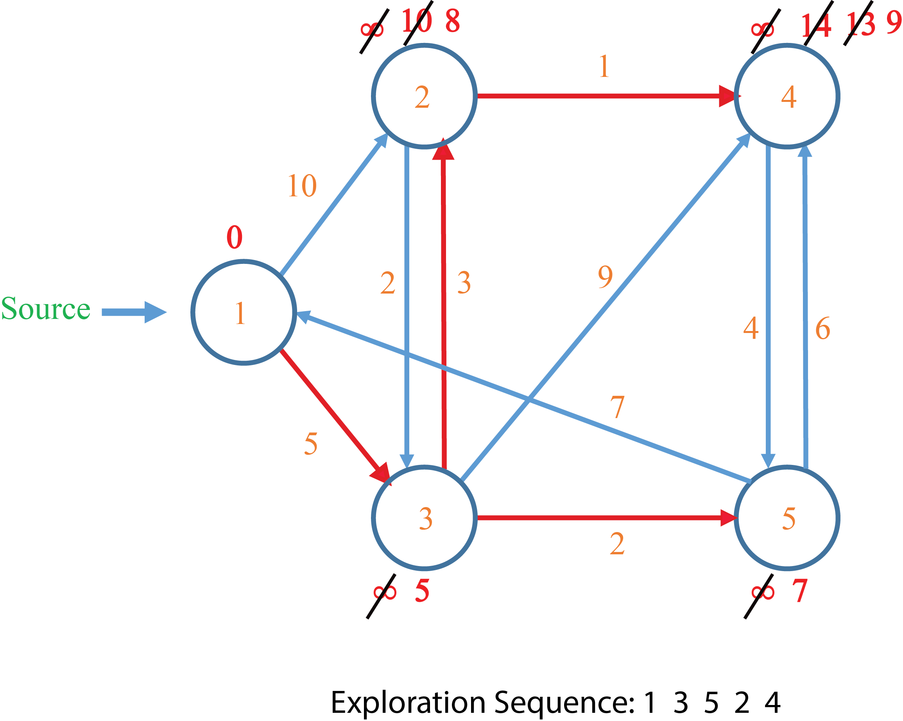
Manual Simulation of Dijkstra Algorithm

Slide 16
Running Time Analysis
O(n)+o(1)+o(nlogn)+o(nlogn)+O(d(V)*logn)
Dijkstra(G)
for each v ∈ V
d[v] = ∞;
d[s] = 0;
Q = V;
while (Q ≠ ∅)
u = ExtractMin(Q);
for each v ∈ u->Adj[]
if (d[v] > d[u]+w(u,v))
d[v] = d[u]+w(u,v);
= o(nlogn)+o(nlogn)+O(d(V)*logn)
O(n)
= o(2nlogn)+O(d(V)*logn)
= o(nlogn)+O(d(V)*logn)
O(1)
= o(nlogn)+O(2m*logn)
O(nlogn)
= o(nlogn)+O(mlogn)
Can achieve O(nlg n + m) with Fibonacci heaps
O(logn)
O(logn)+ o(d(u)*logn)
O(d(u))
O(d(u)*logn)
O(logn)
A hidden cost is here. Here a decrease key function is called in the priority queue
O(nlogn)+ o(d(V)*logn)
The decrease key function runs in O(logn) complexity

Slide 17
Relaxation
Dijkstra(G)
for each v ∈ V
d[v] = ∞;
d[s] = 0;
Q = V;
while (Q ≠ ∅)
u = ExtractMin(Q);
for each v ∈ u->Adj[]
if (d[v] > d[u]+w(u,v))
d[v] = d[u]+w(u,v);
Relaxation

Slide 18
Weight Reduction
Does the shortest path remain same after reducing same amount of weight from all edges?
10
2
20
B
C
10
12
B
C
2
A
E
A
E
15
D
20
7
D
12
Shortest path from A to E: A->D->E
Shortest path from A to E: A->B->C->E
Reduce 8 from each edge
Shortest path doesn’t remain same after weight reduction

Slide 19
Negative Weight Cycle
If a graph G(V,E) contains a cycle C such that V1 → V2 →.... → Vk → V1 and weight of the edges are respectively
w1,w2….wk then weight of the cycle W( C ) = w1 + w2 + ….. + wk
If for a cycle C, w(c) is negative then C is a Negative Weight Cycle
C
3
C
3
-5
10
-20
10
1
2
1
2
-3
-3
W( C ) = 10 - 5 - 3 = 2
W( C ) = 10 - 20 - 3 = -13
Not a Negative Weight Cycle
Negative Weight Cycle

Slide 20
Graph With Negative Weight
15
∞
C
C
10
-5
0
∞
∞
∞
10
17
5
5
A
B
D
3
A
B
D
E
-3
12
Find the shortest path from A to E by Dijkstra’s Algorithm

Slide 21
Graph With Negative Weight
15
∞
C
C
10
-5
0
∞
∞
10
17
∞
13
5
5
A
B
D
3
E
A
B
D
E
-3
12
Find the shortest path from A to E by Dijkstra’s Algorithm
Shortest path: A -> B -> C -> D -> E

Slide 22
Graph With Negative Weight Cycle
15
∞
C
C
10
-20
0
∞
∞
∞
-5
17
5
5
A
B
D
3
A
B
D
E
-3
12
Find the shortest path from A to E by Dijkstra’s Algorithm

Slide 23
Graph With Negative Weight Cycle
15
∞
C
C
10
-5
0
∞
∞
10
17
∞
-2
5
5
A
B
D
3
E
A
B
D
E
-3
12
Find the shortest path from A to E by Dijkstra’s Algorithm
Shortest path: A -> B -> C -> D -> E
But the graph has no solution
Dijkstra’s algorithm fails here

Slide 24
Limitations of Dijkstra’s Algorithm
If a graph having any negative weight cycle, then the graph may not have shortest path for all vertices from the source
In that case if we apply Dijkstra’s algorithm on the graph for computing the shortest path from source to all vertices
the algorithm will return a false solution
Dijkstra’s algorithm is unable to detect negative weight cycle in a graph
Bellman Ford’s algorithm can detect negative weight cycle in a graph and returns false in that case

Slide 25
Bellman Ford Algorithm
Relax all the edges for 4 time in any order
BellmanFord()
for each v ∈ V
d[v] = ∞;
d[s] = 0;
for i=1 to |V|-1
for each edge (u,v) ∈ E
Relax(u,v,w);
for each edge (u,v) ∈ E
if (d[v] > d[u] + w(u,v))
return “no solution”;
Relax(u,v,w): if (d[v] > d[u]+w(u,v))
then d[v]=d[u]+w(u,v)
∞
Step 1
C
10
-5
∞
∞
17
0
∞
∞
5
5
A
B
D
3
E
-3
12
d[v]
d[u] + w(u,v)
d[B] = ∞
d[D]-3 = ∞
d[D] = ∞
d[B]+10 = ∞
d[B] = ∞
d[C]-5 = ∞
d[E] = ∞
d[D]+3 = ∞
d[E] = 17
d[A]+5 = 5
d[B]+12 = 17
No Change!
No Change!
No Change!
Relax
No Change!
Relax
Step 1 done!
Relaxation Process

Slide 26
Bellman Ford Algorithm
Relax all the edges for 4 time in any order
BellmanFord()
for each v ∈ V
d[v] = ∞;
d[s] = 0;
for i=1 to |V|-1
for each edge (u,v) ∈ E
Relax(u,v,w);
for each edge (u,v) ∈ E
if (d[v] > d[u] + w(u,v))
return “no solution”;
Relax(u,v,w): if (d[v] > d[u]+w(u,v))
then d[v]=d[u]+w(u,v)
15
∞
Step 2
C
10
-5
∞
∞
17
0
∞
∞
5
5
A
B
D
3
E
-3
12
d[v]
d[u] + w(u,v)
d[D]-3 = ∞
d[D] = ∞
d[C]-5 = ∞
d[E] = 17
d[D]+3 = ∞
d[E] = 17
d[C] = ∞
d[B]+12 = 17
d[B] = 5
d[A]+5 = 5
d[B] = 5
d[B]+10 =15
No Change
No Change
No Change
No Change
Relax
No Change!
Step 2 done!
Relaxation Process

Slide 27
Bellman Ford Algorithm
Relax all the edges for 4 time in any order
BellmanFord()
for each v ∈ V
d[v] = ∞;
d[s] = 0;
for i=1 to |V|-1
for each edge (u,v) ∈ E
Relax(u,v,w);
for each edge (u,v) ∈ E
if (d[v] > d[u] + w(u,v))
return “no solution”;
Relax(u,v,w): if (d[v] > d[u]+w(u,v))
then d[v]=d[u]+w(u,v)
15
∞
Step 3
No!
C
-5
Relax
10
∞
∞
17
0
10
∞
∞
13
5
5
3
Relax
A
B
D
E
No!
No!
-3
No!
12
Step 3 done!
Relaxation Process

Slide 28
Bellman Ford Algorithm
Relax all the edges for 4 time in any order
BellmanFord()
for each v ∈ V
d[v] = ∞;
d[s] = 0;
for i=1 to |V|-1
for each edge (u,v) ∈ E
Relax(u,v,w);
for each edge (u,v) ∈ E
if (d[v] > d[u] + w(u,v))
return “no solution”;
Relax(u,v,w): if (d[v] > d[u]+w(u,v))
then d[v]=d[u]+w(u,v)
15
∞
Step 4
No!
C
-5
Relax
10
∞
∞
17
0
10
∞
∞
13
5
5
A
B
D
3
E
No!
No!
No!
-3
No!
No!
No!
12
Step 4 done!
Relaxation Process

Slide 29
Bellman Ford Algorithm
Relax all the edges for 4 time in any order
BellmanFord()
for each v ∈ V
d[v] = ∞;
d[s] = 0;
for i=1 to |V|-1
for each edge (u,v) ∈ E
Relax(u,v,w);
for each edge (u,v) ∈ E
if (d[v] > d[u] + w(u,v))
return “no solution”;
Relax(u,v,w): if (d[v] > d[u]+w(u,v))
then d[v]=d[u]+w(u,v)
15
∞
Checking
No!
C
-5
Relax
10
∞
∞
17
0
10
∞
∞
13
5
5
A
B
D
3
E
No!
No!
No!
-3
No!
No!
No!
12
So, the graph has a solution
Checking
The calculated distance for every vertex is shortest
Relaxation Process

Slide 30
Bellman Ford Algorithm (For No Solution)
Relax all the edges for 4 time in any order
BellmanFord()
for each v ∈ V
d[v] = ∞;
d[s] = 0;
for i=1 to |V|-1
for each edge (u,v) ∈ E
Relax(u,v,w);
for each edge (u,v) ∈ E
if (d[v] > d[u] + w(u,v))
return “no solution”;
Relax(u,v,w): if (d[v] > d[u]+w(u,v))
then d[v]=d[u]+w(u,v)
15
∞
Step 1
Relax
C
10
-20
∞
∞
0
∞
-5
4
-8
-2
5
∞
5
3
A
B
D
E
Relax
Relax
-3
Relax
Relax
12
Step 1 done!
Relaxation Process

Slide 31
Bellman Ford Algorithm (For No Solution)
Relax all the edges for 4 time in any order
BellmanFord()
for each v ∈ V
d[v] = ∞;
d[s] = 0;
for i=1 to |V|-1
for each edge (u,v) ∈ E
Relax(u,v,w);
for each edge (u,v) ∈ E
if (d[v] > d[u] + w(u,v))
return “no solution”;
Relax(u,v,w): if (d[v] > d[u]+w(u,v))
then d[v]=d[u]+w(u,v)
15
2
∞
Step 2
Relax
C
10
-20
∞
-18
∞
0
-15
∞
-5
4
-8
-2
-21
5
∞
5
3
No!
A
B
D
E
Relax
Relax
-3
No!
Relax
12
Step 2 done!
Relaxation Process

Slide 32
Bellman Ford Algorithm (For No Solution)
Relax all the edges for 4 time in any order
BellmanFord()
for each v ∈ V
d[v] = ∞;
d[s] = 0;
for i=1 to |V|-1
for each edge (u,v) ∈ E
Relax(u,v,w);
for each edge (u,v) ∈ E
if (d[v] > d[u] + w(u,v))
return “no solution”;
Relax(u,v,w): if (d[v] > d[u]+w(u,v))
then d[v]=d[u]+w(u,v)
15
2
∞
-11
Step 3
Relax
C
10
-20
∞
-18
∞
0
-15
∞
-5
4
-8
-2
-21
5
∞
5
3
A
B
D
E
No!
No!
No!
-3
No!
No!
12
Step 3 done!
Relaxation Process

Slide 33
Bellman Ford Algorithm (For No Solution)
Relax all the edges for 4 time in any order
BellmanFord()
for each v ∈ V
d[v] = ∞;
d[s] = 0;
for i=1 to |V|-1
for each edge (u,v) ∈ E
Relax(u,v,w);
for each edge (u,v) ∈ E
if (d[v] > d[u] + w(u,v))
return “no solution”;
Relax(u,v,w): if (d[v] > d[u]+w(u,v))
then d[v]=d[u]+w(u,v)
15
2
∞
-11
Step 4
No!
C
10
-20
∞
-18
∞
0
-31
-15
∞
-5
4
-8
-2
-21
5
∞
5
3
A
B
D
E
No!
No!
-3
No!
Relax
No!
12
Step 4 done!
Relaxation Process

Slide 34
Bellman Ford Algorithm (For No Solution)
Relax all the edges for 4 time in any order
BellmanFord()
for each v ∈ V
d[v] = ∞;
d[s] = 0;
for i=1 to |V|-1
for each edge (u,v) ∈ E
Relax(u,v,w);
for each edge (u,v) ∈ E
if (d[v] > d[u] + w(u,v))
return “no solution”;
Relax(u,v,w): if (d[v] > d[u]+w(u,v))
then d[v]=d[u]+w(u,v)
15
2
∞
-11
Checking
C
10
-20
∞
-18
∞
0
-31
-15
∞
-5
4
-8
-2
-21
5
∞
5
3
A
B
D
E
-3
12
Checking
Returning “no solution”
Bellman Ford algorithm can detect negative weight cycle
Relaxation Process

Slide 35
Bellman Ford Algorithm (Correctness)
Let the given graph is G(V,E), where we assume that, |V|=n and |E|=m and source vertex is s∈V
Case 1 (No negative weight cycle):
Source is discovered with it’s shortest path at the very beginning of the process
Without source, there are total (n-1) vertices in the graph
In the algorithm, number of iteration for relaxing all the edges is (n-1)
It is ensured that at any iteration at least one vertex is discovered with its shortest distance from source
So, it is ensured that after (n-1) iteration, all the vertices will be discovered with their shortest distance from source
As a result, relaxation of any edge will not be required after (n-1) iteration
So, in this case, the algorithm will return “solution” at the checking step
Case 2 (Negative weight cycle):
Relaxation will be needed for at least one edge at any number of iteration
So, the graph will return “no solution” at the checking step

Slide 36
Bellman Ford Algorithm (Time Complexity)
BellmanFord()
for each v ∈ V
d[v] = ∞;
d[s] = 0;
for i=1 to |V|-1
for each edge (u,v) ∈ E
Relax(u,v,w);
for each edge (u,v) ∈ E
if (d[v] > d[u] + w(u,v))
return “no solution”;
Total time = O(n) + O(1) + O(mn) + O(m) = O(mn)
O(n)
What is the worst case scenario for Bellman Ford algorithm?
If the value of m is maximum
O(1)
For any complete graph, number of m is maximum
For a complete graph, if number of vertices is n then
Number of edges, m = n*(n-1)/2
O(mn)
O(m)
In that case, time complexity of Bellman Ford algorithm is:
O(mn)
= O((n*(n-1)/2) * n)
= O((n² -n) * n)
O(m)
= O(n³ -n²)
= O(n³)
So, in worst case scenario Bellman Ford algorithm can take O(n³) time

